Slide 1
CCDA and FHIR
Lloyd McKenzie
July 24, 2015

Slide 2
These slides
Are licensed for use under the Creative Commons, specifically:
Creative Commons Attribution 3.0 Unported License
(Do with it as you wish, so long as you give credit)
Speaking of which, much of this content comes from slides originally created by Grahame Grieve
The recorded webinar is not creative commons and is not for distribution/sharing

Slide 3

Who am I?
Name: Lloyd McKenzie
Company: Gevity
Background:
One of FHIR’s 3 initial editors
Co-chair FHIR Management Group, Modeling & Methodology, FHIR Infrastructure
Former Chair HL7 Canada Architecture & Infrastructure
Heavily involved in HL7 and healthcare exchange for last 15 years (v2, v3, CDA, etc.)

Slide 4
CDA and FHIR

Slide 5
CDA to FHIR
Through 2010/2011, it became clear that:
CDA was hard to construct and read
Documents aren’t good for granular data exchange
CDA was used for granular data because the alternatives were worse
CDA was getting pushback from implementers
These strategic frustrations were part of why FHIR was invented

Slide 6
CDA to FHIR
The design of FHIR was strongly influenced by CDA:
Support for collecting resources into Documents
CDA content model a first point of reference for Composition
Green CDA simplification led to focus on user-friendly implementation
CDA usage guided our resource priority

Slide 7
FHIR & CDA Commonalities
Both
Break data up into “chunks”
Resources vs. “entries”
Based on RIM (though different approaches)
Convey both Narrative and discrete data
Make use of profiling/templating
Provide support for documents
Have a single world-wide schema for conformant instances

Slide 8
Differences
FHIR does more than documents
REST, Messaging & services
Create, update & delete individual records
E.g. A single allergy, procedure, etc.
Share collections of data with associated behavior
Merge, query, replace
Exchange data with no expectation of full or combined persistence
E.g. ADT type “broadcast” messages
All exchange mechanisms use the same schema

Slide 9
Differences (cont’d)
FHIR does more than clinical documents
Can have a subject of anything (e.g. SPL)
Looser constraints than for “good practice” clinical documents
Profile of CDA equivalent – CDA on FHIR

Slide 10
Differences (cont’d)
FHIR supports multiple syntaxes
XML & JSON, plus soon RDF
JSON works well for mobile/web
RDF for semantic web
FHIR instances are more readable
FHIR names and structure are business-driven
RIM mappings are hidden
No classCodes, moodCodes, 10 levels of nesting
Abstraction = complexity, higher learning curve

Slide 11
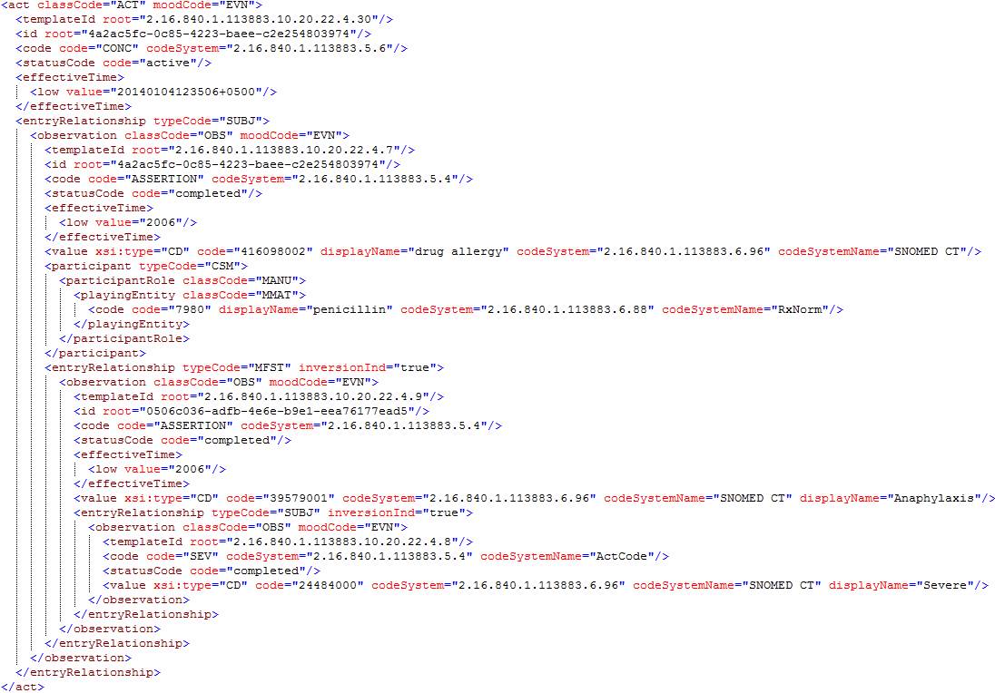
CDA example

Slide 12
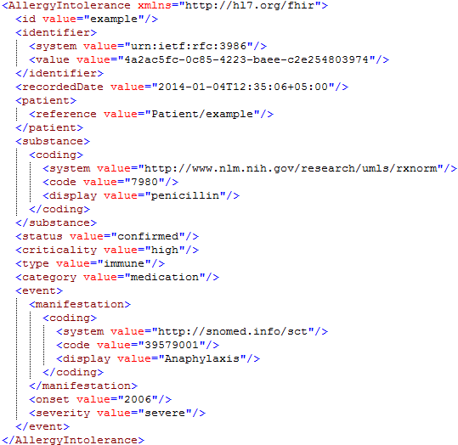
FHIR equivalent

Slide 13
Differences (cont’d)
FHIR breaks data into multiple resources
each independently maintainable
Linkages are by reference (allows resources to exist as a web)
FHIR passes narrative around with each resource
Not tied to the document section

Slide 14
Differences (cont’d)
FHIR supports “drive by” interoperability
Can get a base level of interoperability without profiles/templates
Still need profiles/templates for “guaranteed” interoperability
FHIR focuses on “common” use-cases
Base spec is simple
Extensibility model for edge cases
Done within the schema
Extensions are discoverable by URL

Slide 15
Structure of a FHIR Document

Slide 16
Nurse Smith Practitioner
FHIR Document
Discharge
Summary Composition
Dr. Bernard Practitioner
author
Patient Mary Patient
subject
Chief Complaint section
Kidney Stones Condition
content
Pulse Observation
Physical section
Vital Signs list
entry
BP Observation
content
Medications section
Discharge Meds list
Dyclofenac MedicationPrescription
content
entry
Tamsulosin MedicationPrescription
Notes:
This is how you might create a document from scratch

Slide 17
Documents are bundles
<bundle>
<entry>
<Composition />
</entry>
<entry>
<List />
</entry>
<entry>
<Observation />
</entry>
<entry>
<Condition />
</entry>
<entry>
<Patient />
</entry>
</bundle>
Composition Resource
Section
Metadata
Attester
Section
List Resource
Observation Resource
Condition Resource
Patient Resource
Notes:
A Document, no matter how nested, is flattened to a list of entries, the Document’s header being the first.
The document header (and any other the other resources) refer to each other using normal references to reflect the document’s nesting.
Of course, there may be a digital signature (on the whole Bundle) to attest to the content of the document.

Slide 18
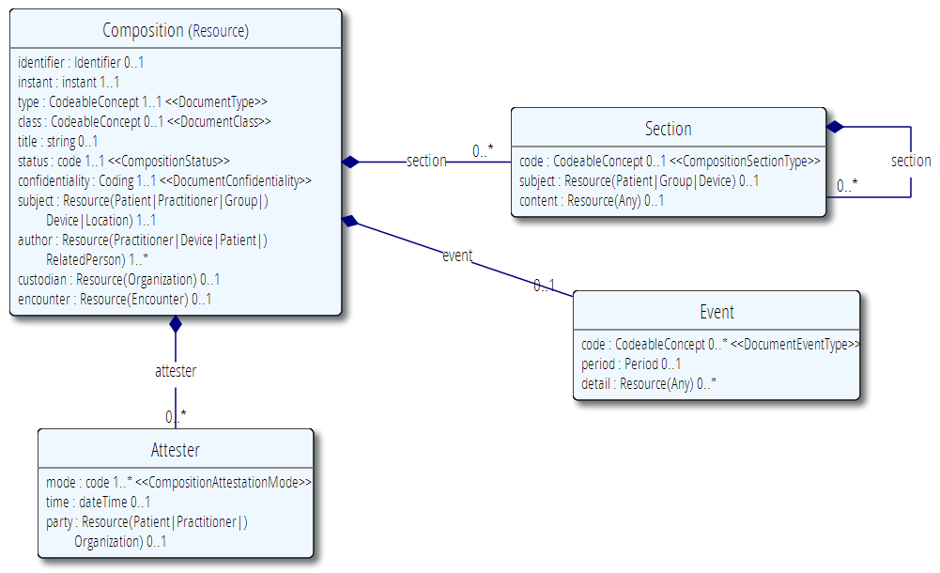
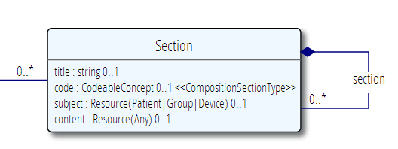
The Document resource
A single Resource, very often a List

Slide 19
Documents vs. APIs

Slide 20
Document Characteristics
Clinical documents have 6 characteristics:
Persistence
Stewardship
Potential for authentication
Context
Wholeness
Human readability

Slide 21
Documents vs. APIs
Those characteristics are necessary in types of healthcare exchanges
Lab, pathology & surgery reports
Discharge summaries, Referral letters
Not appropriate for all problems
On-the-fly filtered queries
Dynamic objects (e.g. orders with status changes)
Registries
Sometimes we care about just data, sometimes context & story is important

Slide 22
Documents vs APIs
Packaged Access
Trust from document context & obligations
Independent of system integration
Import data from documents
Granular Access
System-based trust framework
Tightly integrated IT and business systems
Export data from APIs

Slide 23
Documents vs APIs
Documents are the correct way to exchange information between clinicians in disparate parts of the healthcare system
APIs will integrate access to the data between applications where the context is unambiguous.
Both the document and API should seamlessly use the same syntax and semantics and Narrative approach

Slide 24
CDA on FHIR

Slide 25
CDA -> FHIR project
Map CDA header to FHIR
Resolve issues around sections in FHIR
Map basic CDA entries to FHIR (general)
Map CCDA sections & entries to FHIR (specific)

Slide 26
CDA -> FHIR Project
Work is in a Google spreadsheet
Targeting inclusion in DSTU 2.1
Ballot Jan, 2015
Ongoing calls on a weekly basis
https://docs.google.com/spreadsheets/d/1KctdexG3oB2QBiBQNH1Rbt2uJ6DxQFROyIFKo5q95WU/edit#gid=1223244219

Slide 27
Working Spreadsheet
Mapping CDA header and basic entry types to FHIR
Evaluating cardinality, conformance, data type, vocabulary binding, etc.
Occasionally may diverge from CDA R2
Only if understanding of clinical documents have changed
Can’t map all of the right-hand side of CDA
Too abstract – can say an unlimited number of things numerous ways

Slide 28
CDA Profile in FHIR
http://hl7-fhir.github.io/cda.html
Profiles and Extensions
Very incomplete
This will develop as the project goes on

Slide 29
Conversion
Conversion from FHIR to CDA is possible, though no guarantee of interoperability
Most interoperability in CDA is via template
Many ways systems might expect the same data to be represented
FHIR extensions can only be converted if conversion algorithm knows the extension
Linkages from narrative to discrete data may lose granularity
Best conversion is template/IG-specific

Slide 30
Conversion (cont’d)
Conversion from CDA to FHIR must be template-specific
CDA can say too many things too many ways to allow conversion
In principle, all data expressible in CDA can be converted
Some may map to extensions

Slide 31
CCDA
(finally!)

Slide 32
CCDA
“Consolidated CDA”
Release 1.1 published July, 2012
Release 2 published Nov, 2014
Release 2.1 in development
Harmonised several US and IHE CDA implementation guide
In service of “Meaningful Use Minimal Data Set” though it includes more

Slide 33
CCDA → FHIR
Mapping is underway
Partially funded by Argonaut
Preliminary assessment complete before DSTU 2 publication
Publication of IG won’t occur until 2.1 (ish)

Slide 34
CCDA <-> FHIR Conversion
CCDA is hard to understand, and there is significant variance in its use
CCDA is an “open” standard – anything not prohibited is allowed, which makes mapping challenging
FHIR extensions can only be mapped if known

Slide 35
Conversion cont’d
Implementing a “FHIR” C-CDA and converting to v3 C-CDA is possible
Relies on using only “C-CDA”-specific extensions
Converting from C-CDA to FHIR may need to be customized for specific C-CDA implementations
Can do base conversion of header and narrative, but discrete data may not be reliable

Slide 36
What’s happening w/ Meaningful Use?
Predicting govn’t is hard
FHIR is not yet locked into backward compatibility, so requiring by regulation premature
Regulations may focus more on clinical objectives, less on specific technology
ONC is sponsoring DAF project
Discrete data exchange without documents

Slide 37
Longer term
Agreement in principle that next “major” C-CDA release will be expressed in both v3 & FHIR forms
Should simplify migration and interoperability
Market will determine whether CDA transitions to FHIR or whether they co-exist
Will also determine timeframes

Slide 38


Questions?
http://hl7.org/fhir lmckenzie@gevityinc.com

